Slide 1
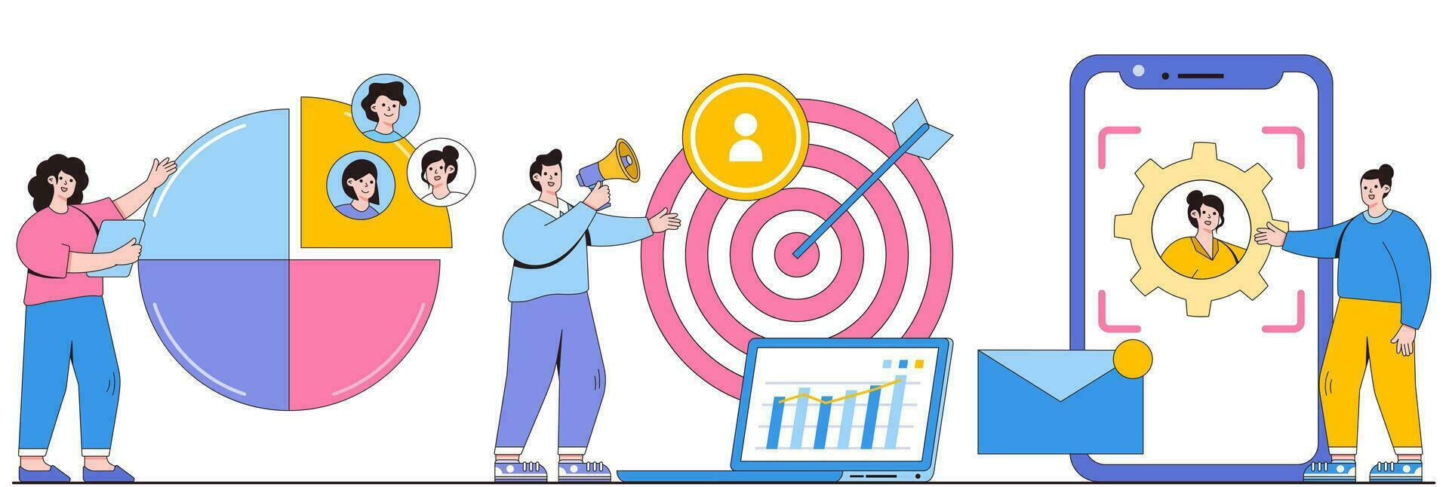

Assignment: Customer Segmentation
By:
Yasika Sawant
MS in Applied Business Analytics Student
Faculty: Prof. Laureano Paredes & Prof. Anubhavi Gupta

Slide 2

Objective :
The goal of this analysis is to conduct an Exploratory Data Analysis (EDA) on the given customer dataset. The primary objectives are:
Data Cleaning and Preprocessing: Identify and handle any missing or inconsistent values in the dataset.
Exploratory Data Analysis (EDA):
Investigate the relationships between key variables such as Age and Spending Score.
Analyze the distribution of various features (e.g., Age, Spending Score, and Gender).
Visualize these relationships and distributions through various charts and plots to uncover patterns and insights.
Customer Segmentation: Using the KMeans clustering algorithm, segment customers into distinct groups based on their Age and Spending Score.
Visualize the resulting clusters to identify customer segments.
Provide summary statistics for each cluster to describe the average characteristics of the customer groups.
Tables and Summaries:
Provide tables summarizing key metrics and insights, including the characteristics of each identified cluster.

Slide 3
Introduction:
Customer segmentation is a crucial step in understanding the diversity within a customer base. By grouping customers with similar characteristics, businesses can tailor marketing strategies, improve customer service, and optimize product offerings to meet the specific needs of each group. In this analysis, we aim to explore and segment customers based on their Age and Spending Score using a KMeans clustering approach.
The dataset consists of key customer attributes, including Age, Spending Score, and Gender, which provide insights into both demographic information and purchasing behavior. Through Exploratory Data Analysis (EDA), we will first examine the distribution of these features and investigate the relationships between them. Visualizations, such as histograms, scatter plots, and pair plots, will be used to identify patterns and trends.
The primary focus of this analysis is on KMeans clustering, which will be employed to segment the customers into distinct groups based on the similarities between their Age and Spending Score. The optimal number of clusters will be determined using the Elbow Method. The clusters will then be analyzed and visualized to provide a clear understanding of customer behavior and segment characteristics.
This analysis will provide valuable insights into customer segments, helping businesses design targeted marketing campaigns and optimize customer engagement strategies. The results, including cluster summaries and visualizations, will be presented in a clear and concise manner to facilitate decision-making.

Slide 4
Exploratory Data Analysis (EDA) and Relation between Variables :
The purpose of Exploratory Data Analysis (EDA) is to uncover underlying patterns, trends, and relationships in the dataset. In this analysis, we focus on the relationships between key customer attributes such as Age, Spending Score, and Gender. The following steps outline the EDA process:
1. Data Inspection and Preprocessing
Data Structure: We begin by inspecting the data's structure, including its shape, data types, and any missing values. This is important to ensure the integrity of the dataset before proceeding with further analysis.
Missing Data: We identify and handle any missing or null values. In this case, we checked for missing values in both the train_data and test_data to ensure completeness.
2. Univariate Analysis (Distribution of Variables)
We analyze the distribution of individual variables to understand their characteristics:
Age Distribution: We visualize the distribution of customer ages using a histogram, allowing us to see if the data is normally distributed or skewed.
Spending Score Distribution: Similarly, we analyze the distribution of spending scores to understand the variance in customer spending behavior.
Gender Distribution: A countplot of the gender feature helps us assess the balance of male and female customers in the dataset.
Bivariate Analysis (Relationships Between Variables)
We then explore the relationships between pairs of features to gain insights into how they interact:
Age vs. Spending Score: A pairplot is used to visualize the relationship between Age and Spending Score. This helps identify any potential clusters or trends between these two variables.
Data Transformation
Label Encoding: For categorical variables like Gender, we use Label Encoding to convert text labels into numeric form, making them suitable for machine learning algorithms.
Feature Scaling: We standardize the continuous features (Age and Spending Score) to ensure that they are on the same scale, which is important for clustering algorithms like KMeans.

Slide 5
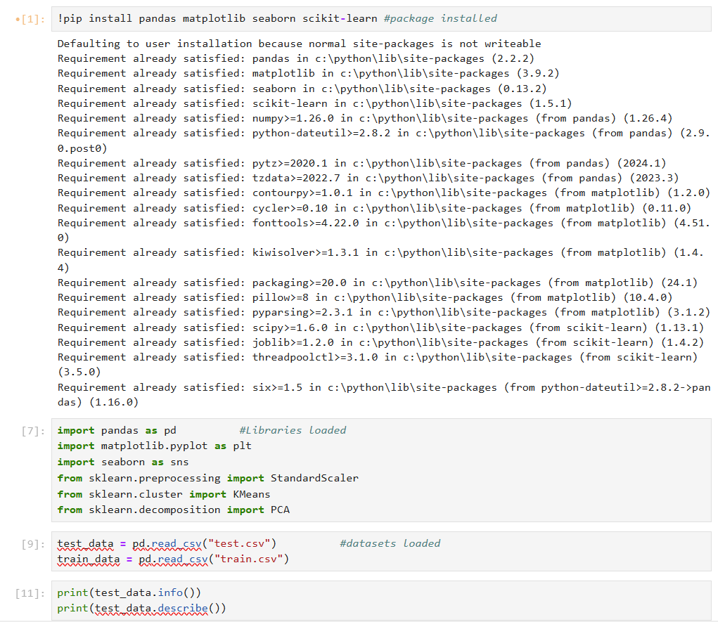
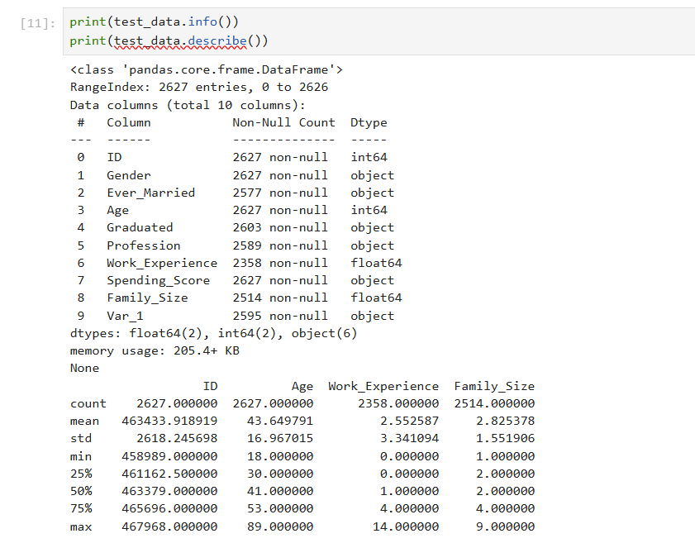
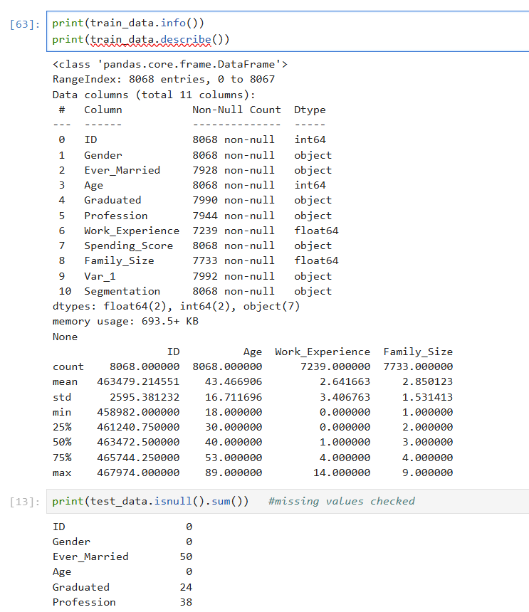
Exploratory Data Analysis (EDA) and Relation between Variables
Libraries and Datasets loaded

Slide 6
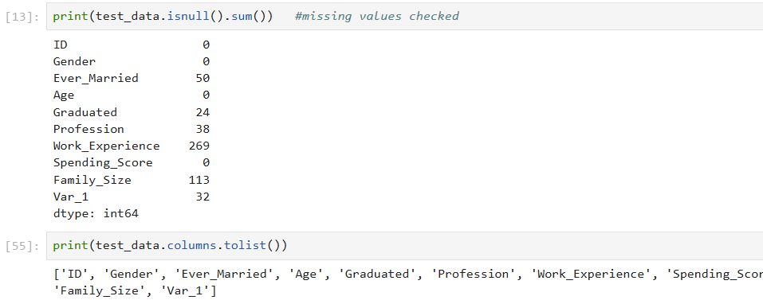
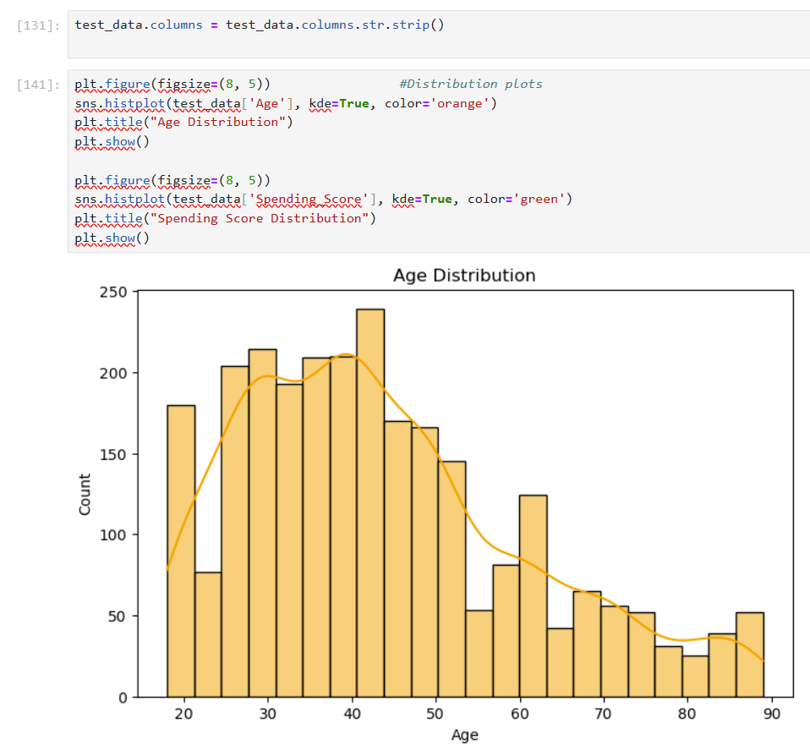
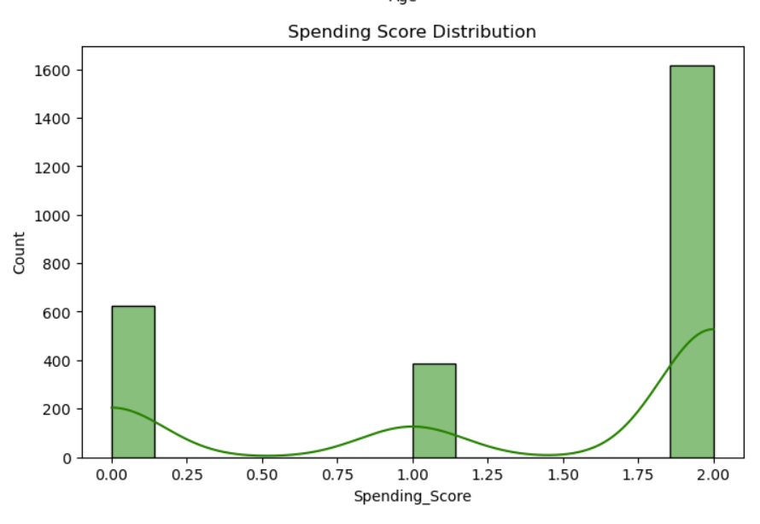
Exploratory Data Analysis (EDA) and Relation between Variables
Checked Missing Values

Slide 7
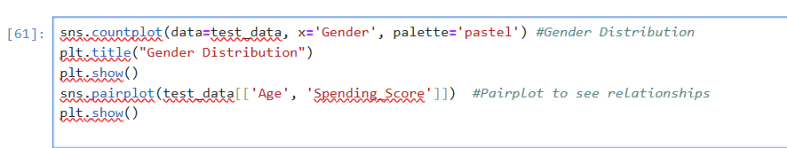
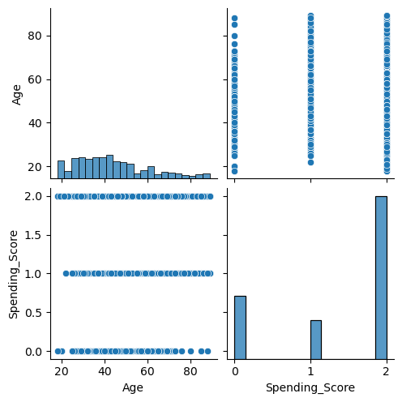
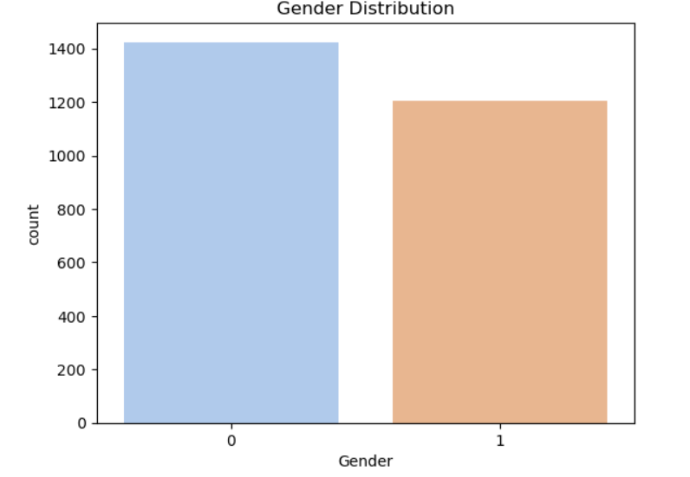
Exploratory Data Analysis (EDA) and Relation between Variables

Slide 8
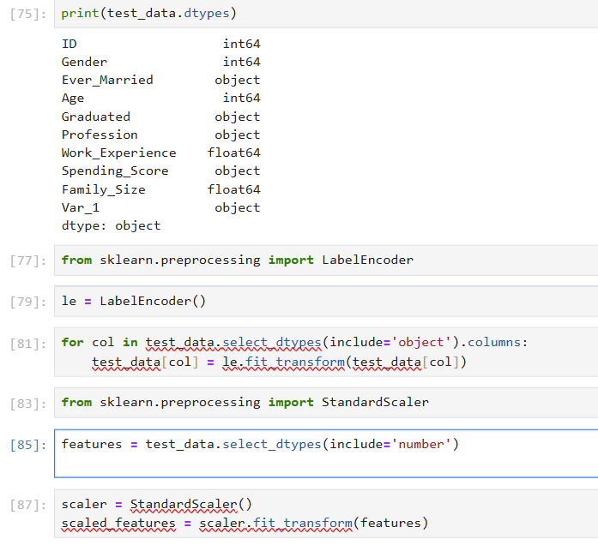
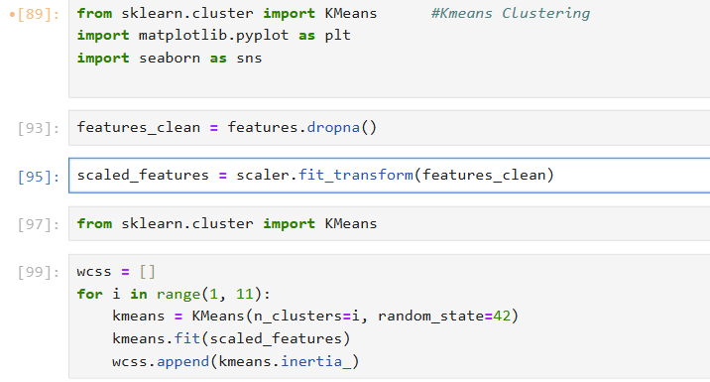
Data Transformation for K-means Clustering:
Labels Encoded and standardized scale

Slide 9
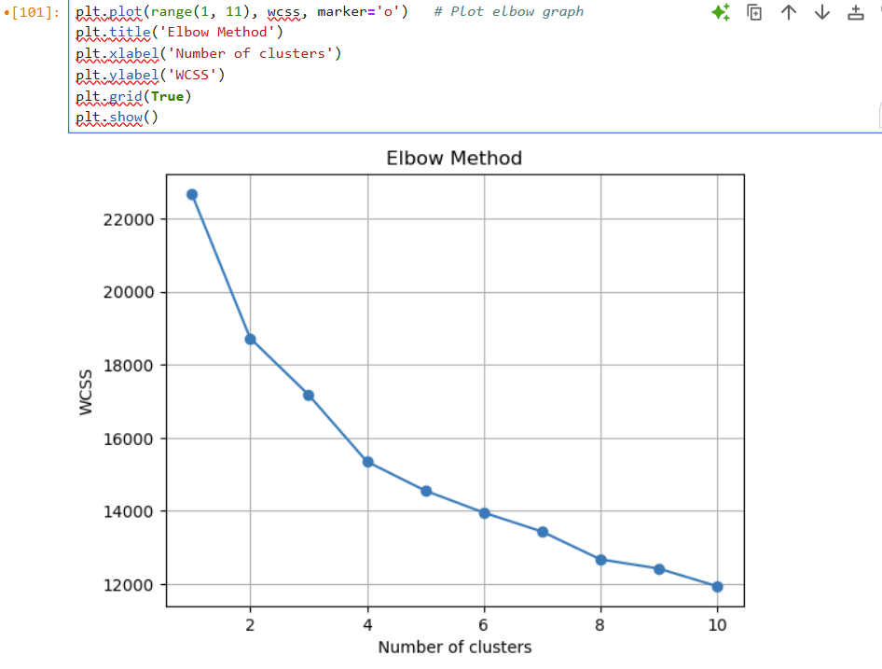
K-means Clustering:

Slide 10
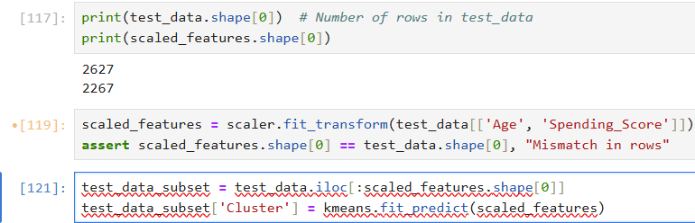
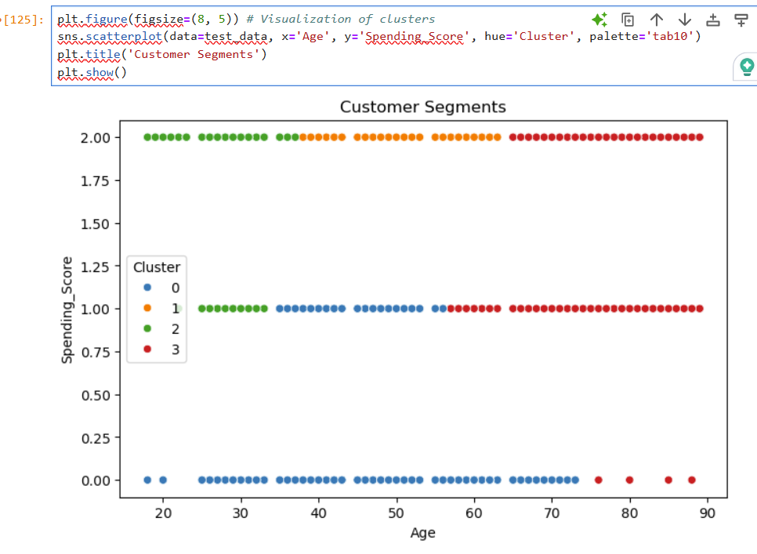
K-means Clustering Visualization:

Slide 11
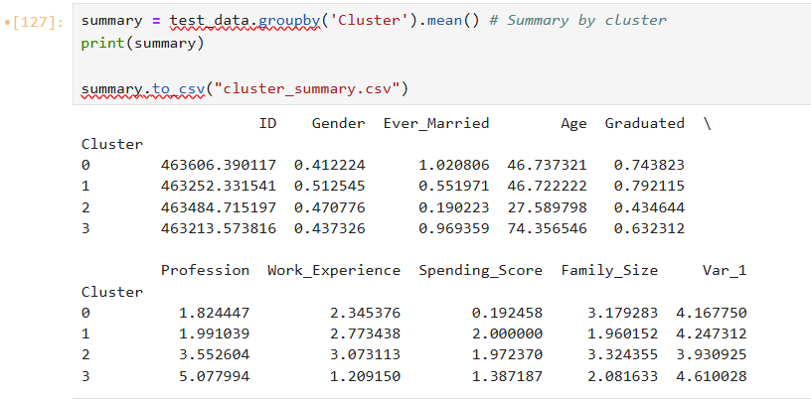
K-means Clustering Table Summarization:

Slide 12
Conclusion:
In this analysis, we explored and segmented customers based on their Age and Spending Score using KMeans clustering. The primary objectives were to uncover patterns and relationships in the data, visualize customer behavior, and group similar customers into distinct segments.
Data Insights:
We found that the Age and Spending Score distributions exhibited certain patterns, with age showing a relatively diverse range and spending scores demonstrating variation among customers.
The Gender distribution was balanced, with no significant skew toward either gender, ensuring a fair representation of both groups in the dataset.
Clustering:
By applying the KMeans clustering algorithm, we identified four distinct customer segments based on their Age and Spending Score. The Elbow Method was used to determine that 4 clusters provided the most meaningful segmentation.
Each cluster revealed unique characteristics, with differences in both Age and Spending Score. These clusters represent distinct customer groups, which can be used to tailor marketing and business strategies.
Customer Segmentation:
The segmentation allows businesses to understand customer behavior better, enabling targeted marketing efforts and personalized customer engagement strategies. For example, segments with high spending scores could be targeted for premium products, while younger segments could be approached with budget-friendly options.
Visualizations:
The visualizations, including scatter plots and histograms, helped us easily identify trends and relationships in the data. The cluster visualization provided clear insights into how customers are grouped based on their attributes.
Summary and Next Steps:
The customer segments derived from this analysis provide a solid foundation for further segmentation and deeper exploration. Future work could include incorporating additional features (e.g., Family size, Profession ) to refine the segmentation and gain even more actionable insights.
The results of this analysis can be used to inform decisions in marketing, customer service, and product development.
In conclusion, this analysis has successfully segmented customers into meaningful groups, providing a deeper understanding of their characteristics and behaviors. These insights are valuable for businesses seeking to improve their customer engagement strategies and optimize resource allocation.

Slide 13
Conclusion:
Thank you

